Slide 1

Twister2 Project
By: Kyanie Waters

Slide 2
Outline
What is Twister2
Twister2 Components
Contributions
Experiment Examples

Slide 3
What is Twister2?
A Composable data analytics hosting environment that supports multiple data analytics including models of computations, streaming, and data pipelines .
Twister2 supports different APIs and Workloads.
The problem: “Researchers struggle with computational problems, while they should be focusing on their research problems.”

Slide 4
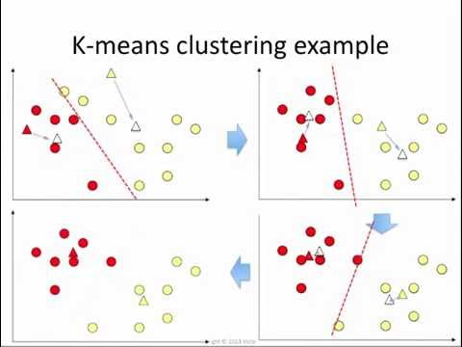
How Twister2 is produced
K-Means Clustering Algorithm

Slide 5
Twister2 Components
HPC
ClusterEnvironments
Standalone
Parallel Computing
OpenMPI
Big Data
Batch Processing (Stored)
Stream Processing (Real Time)
Cluster Environments
Kubernetes
Mesos
Slurm
Nomad

Slide 6
Twister2 Components Continued...
Task System
Task Graph
Task Scheduler
Executor
APIs for streaming and batch applications
Operator API
Task Graph based API
TSet API
Support for storage systems
Local file systems
NFS for persistent storage
HDFS (Hadoop Distributed File System)

Slide 7
Contributions
Experiments
Run Simulations
Workers
Size
Operation
Iteration

Slide 8
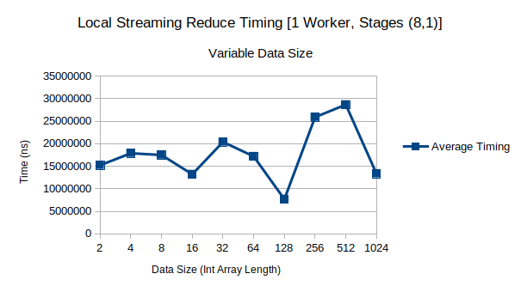
Reduce, 1 Worker, Size 2-1024, 1 iteration

Slide 9
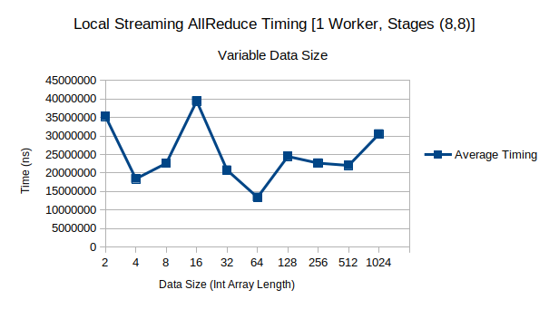
AllReduce, 1 Worker, Size 2-1024, 1 iteration

Slide 10


